Slide 1
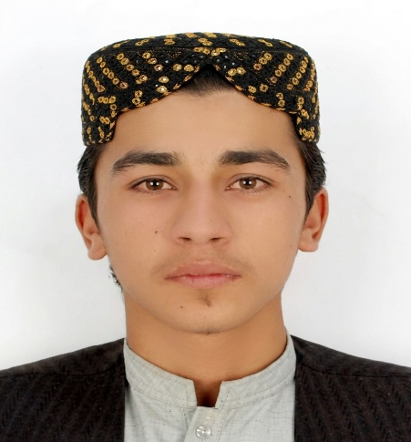









Ahmadullah Ahmadi
Full Stack Web Developer
ABOUT ME
CONTACT
I'm a Full Stack Web Developer based in Kabul, Afghanistan. I build modern, responsive, and user-friendly websites and web applications using modern web technologies. My focus is on creating clean, functional, and practical digital solutions that solve real problems.
+93(0)778266657
wardak.ahmadi333@gmail.com
https://wardakahmadi333-cloud.github.io/ahmadi_development/
https://www.linkedin.com/in/ahmadullah-ahmadi-3311b3401/
https://github.com/wardakahmadi333-cloud
Kabul, Afghanistan
EDUCATION
SKILLS
  HTML5
  CSS3
  JavaScript
  Tailwind CSS
  Bootstrap
  Responsive Design
  RESET APIs
  React.js
  Node.js
  MongoDB
  SQL
  Git & GitHub
2024 – Continues
Shaikh Zayed University
Bachelor in Computer Since
2026
HP Foundation
Effective Business Websites
2026
Code to Inspire
Web Dev Essential
WORK EXPERIENCE
Freelance / Personal Project
Fronted Web Developer
2025 – Present
LANGUAGE
Pashto
Developed responsive websites using HTML, CSS, JavaScript, Tailwind CSS, and Bootstrap. Built reusable UI components and responsive layouts for desktop and mobile devices. Implemented interactive features using JavaScript and DOM manipulation. Integrated frontend applications with REST APIs. Used Git and GitHub for version control and project management. Currently developing Lecwal, a web-based platform focused on Pashto-language digital creation and content tools.
Dari
English
REFERENCE
Available upon request

